Slide 1

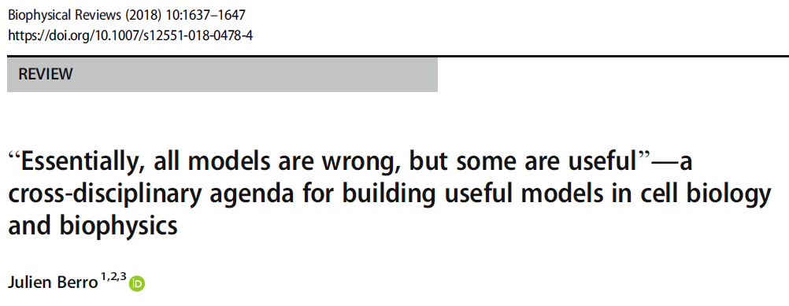
“Essentially, all models are wrong, but some are useful” – George EP Box
Julien Berro
Yale University
Watercolor by Mary D’Alimonte

Slide 2
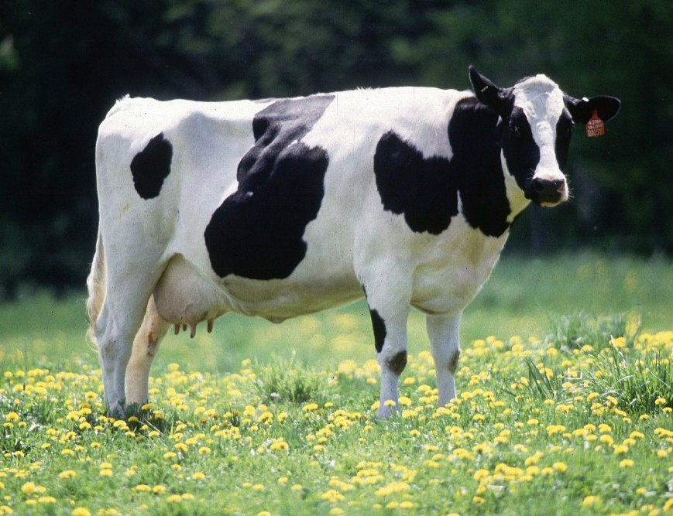
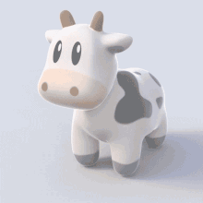
Farmers asked a modeler:
“how can we increase the milk production of our cows?”
https://en.wikipedia.org/wiki/Milk
https://en.wikipedia.org/wiki/Spherical_cow
After several months of hard work, the modeler answered:
“ I have a solution. Let’s consider a spherical cow in a vacuum…”
Berro (Biophysical Reviews 2018)

Slide 3
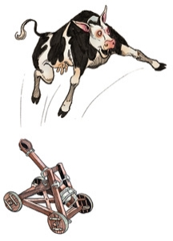
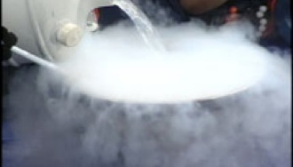
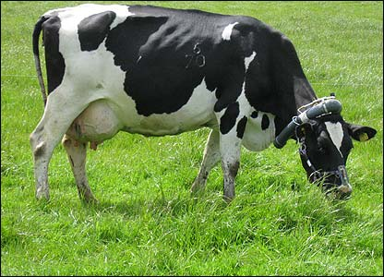

What is an appropriate model for a cow ?
How far can you catapult a cow?
How long does it take
to freeze a cow in liquid Nitrogen?
How to increase the milk production?
???
$$f$$
The biological question determines what model to develop (… if any)
Berro (Biophysical Reviews 2018)

Slide 4
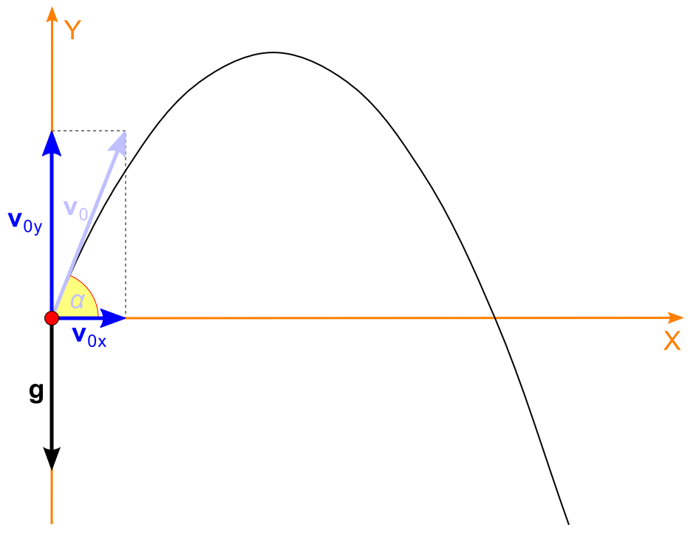

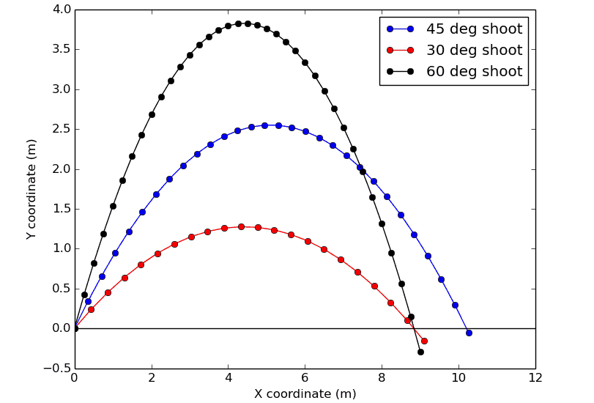
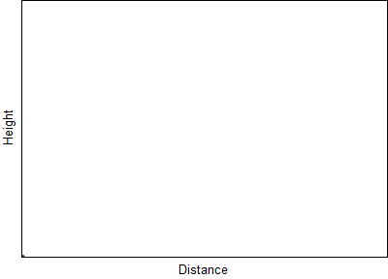

Tentative agenda to build “useful” models in biology
Identify a good question
Determine the most appropriate modeling approach
Implement the model
Identify parameters that fit the data
Explore the space of free parameters / perform a sensitivity analysis
Test alternative hypotheses
Make testable predictions and test them experimentally
Break the model and Repeat!
Berro (Biophysical Reviews 2018)
https://en.wikipedia.org/wiki/Projectile_motion

Slide 5
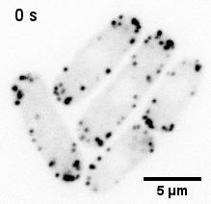
Clathrin-Mediated Endocytosis
Plasma membrane
Cytoplasm
Challenges: Fast | Transient | Diffraction limited | Out of equilibrium
Lacy et al 2018
Berro and Lacy 2018

Slide 6
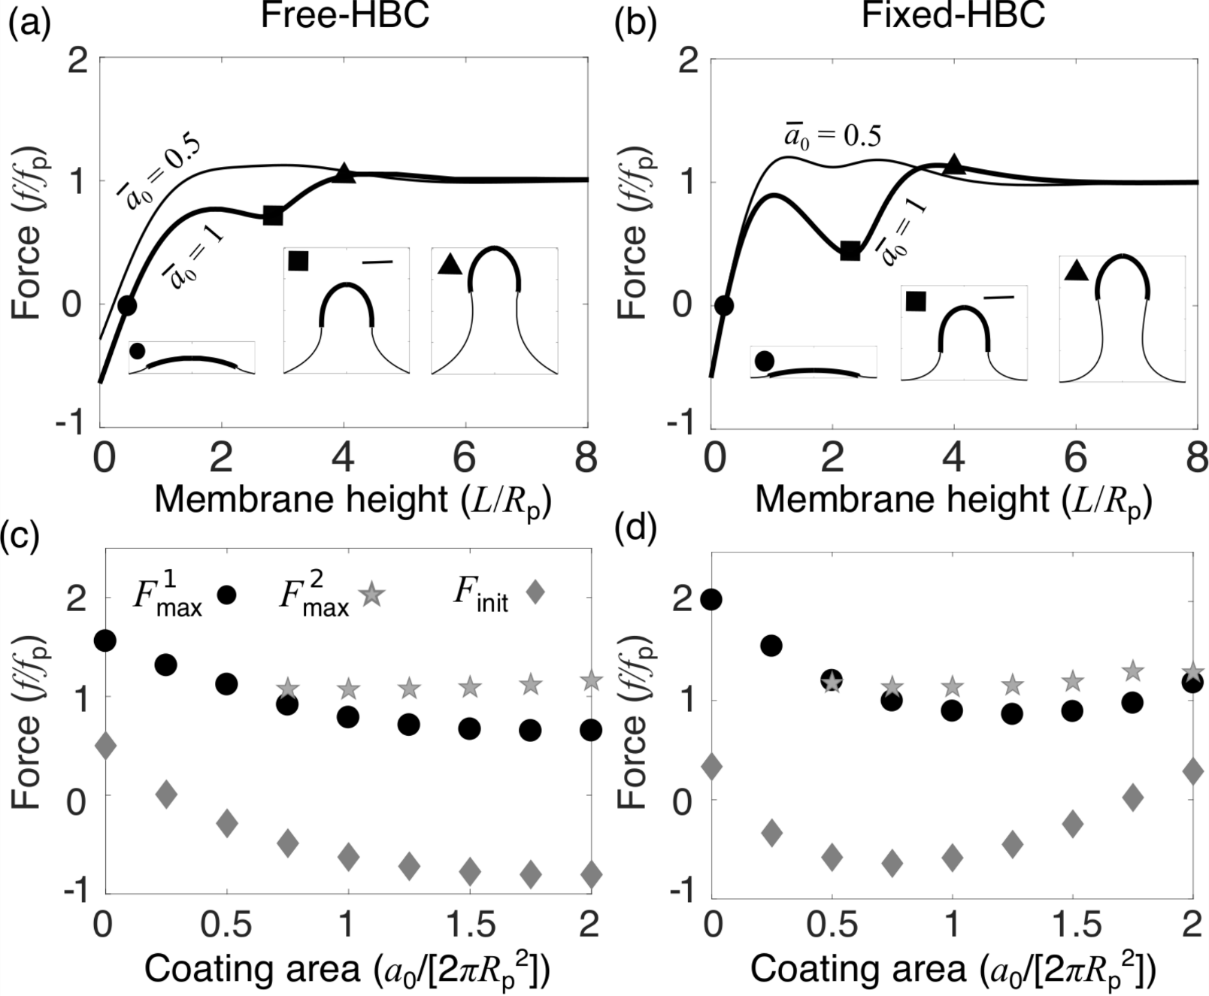
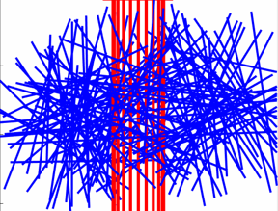
Outline of the rest of the talk
4 models related to endocytosis that
address different questions…
… at different scales and levels of details
use different math/computational approaches
All models
were backed by some experimental data
made predictions
inspired new experiments
inspired new questions

Slide 7
PART I – HOW MUCH FORCE IS REQUIRED FOR ENDOCYTOSIS?
High turgor pressure makes endocytosis difficult to perform in yeast
P ~ 1 MPa ~ 10 atm
Energy costs to deform the membrane:
Membrane tension
Turgor pressure
Bending elasticity
Helfrich 1973
Lacy et al 2018
Berro and Lacy 2018
Ma and Berro (bioRxiv) 2019

Slide 8
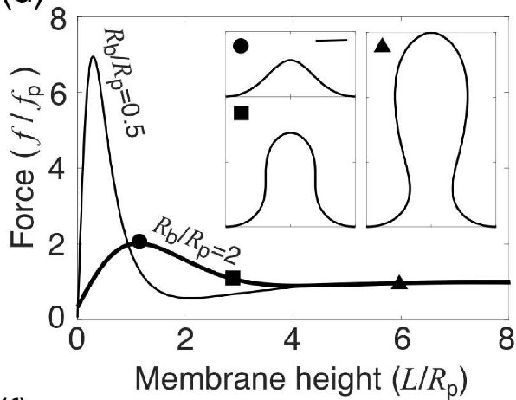


How much force is required to deform the membrane?
If we consider the cell membrane is pure lipids pulled by a point force:
Force barrier
~3000 pN
Tube elongation force
~1000 pN
$$f_{p}∝P^{1/3}$$
$$P: turgor pressure$$
Lacy et al 2018
Berro and Lacy 2018
Ma and Berro (bioRxiv) 2019

Slide 9

But the endocytic pit is not just pure lipids
Parameters (controllable by proteins) that influence the force threshold:
Intrinsic curvature and surface area of the coat (clathrin, etc)
Boundary conditions (how the membrane is attached to the cell wall)
Force barrier disappears when:
Coat surface area ≈ hemisphere
Coat intrinsic curvature ≈ tube radius
Free hinge attachment to the cell wall
Check the scale!
With realistic parameters the force to produce is still ~1000 pN
Rui Ma
Ma and Berro (bioRxiv) 2019

Slide 10
Actin provides the forces to deform the membrane
… but how?
Favorite hypothesis in the field:
The “push-pull” model
Force produced by
actin polymerization alone:
Conservative estimate ~ 15 pN
Optimistic estimate ~ 200 to1000 pN
Lacy et al 2018
This is probably not enough -
Are there other ways to produce force?

Slide 11
Two mechanisms that can help produce more force during endocytosis
Turnover of the actin machinery
Elastic energy storage in actin filament crosslinkers

Slide 12
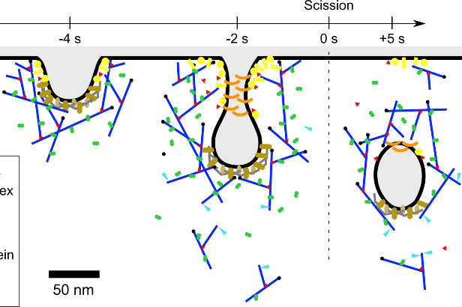
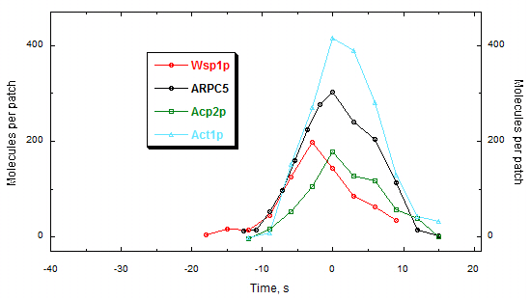
PART II – TURNOVER DURING ENDOCYTOSIS
Why do we think there might be turnover?
A simple model of actin dynamics during endocytosis backed with experimental data predicted it
Quantitative microscopy data allows to count the number of molecules over time
WASp
Arp2/3 complex
Actin (6%)
Capping protein
Number of molecules
Time (s)
Berro et al 2010
Sirotkin et al 2010

Slide 13
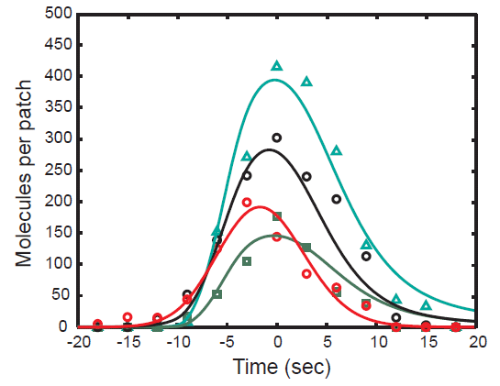
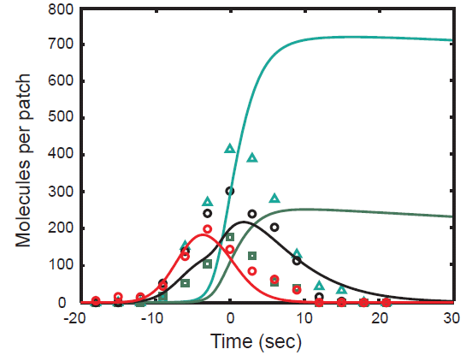
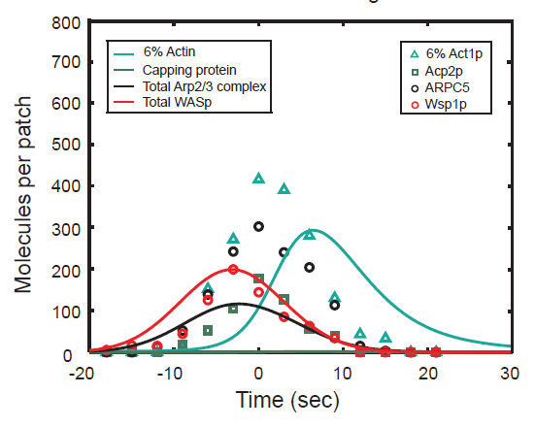
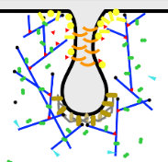
Testing the dendritic nucleation hypothesis with mathematical modeling (0D ODE)
Sirotkin et al 2010
Berro et 2010
Assembly: WASp-driven Arp2/3 complex dendritic nucleation for actin
Disassembly: Pointed-end depolymerization + release of chunks
Most reaction rate constants have been measured in vitro
Cytoplasmic concentrations measured with quantitative microscopy
WASp
Arp2/3
Actin
Capping prot.
Number of molecules
ATP-Actin
Capping protein
WASp
Arp2/3 complex
Actin Patch
`
Pi -release
Cytoplasm
No spatial details
ADF/cofilin
ADP-Actin

Slide 14
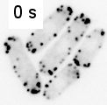
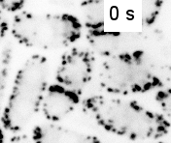
This simple ODE model allowed us to make several predictions that are experimentally testable
ADF/cofilin releases chunks of the actin network in the cytoplasm
  ✓ Validated by Chen and Pollard JCB 2013
S. pombe actin and Arp2/3 complex have faster dynamics in vivo
  ✓ Validated by Ti and Pollard, JBC 2011
  and by Arasada and Pollard Curr Biol 2011
Actin filaments turn over about 3 times during the entire time course
Wild-type
adf1-M2 (Chen & Pollard, 2013)

Slide 15
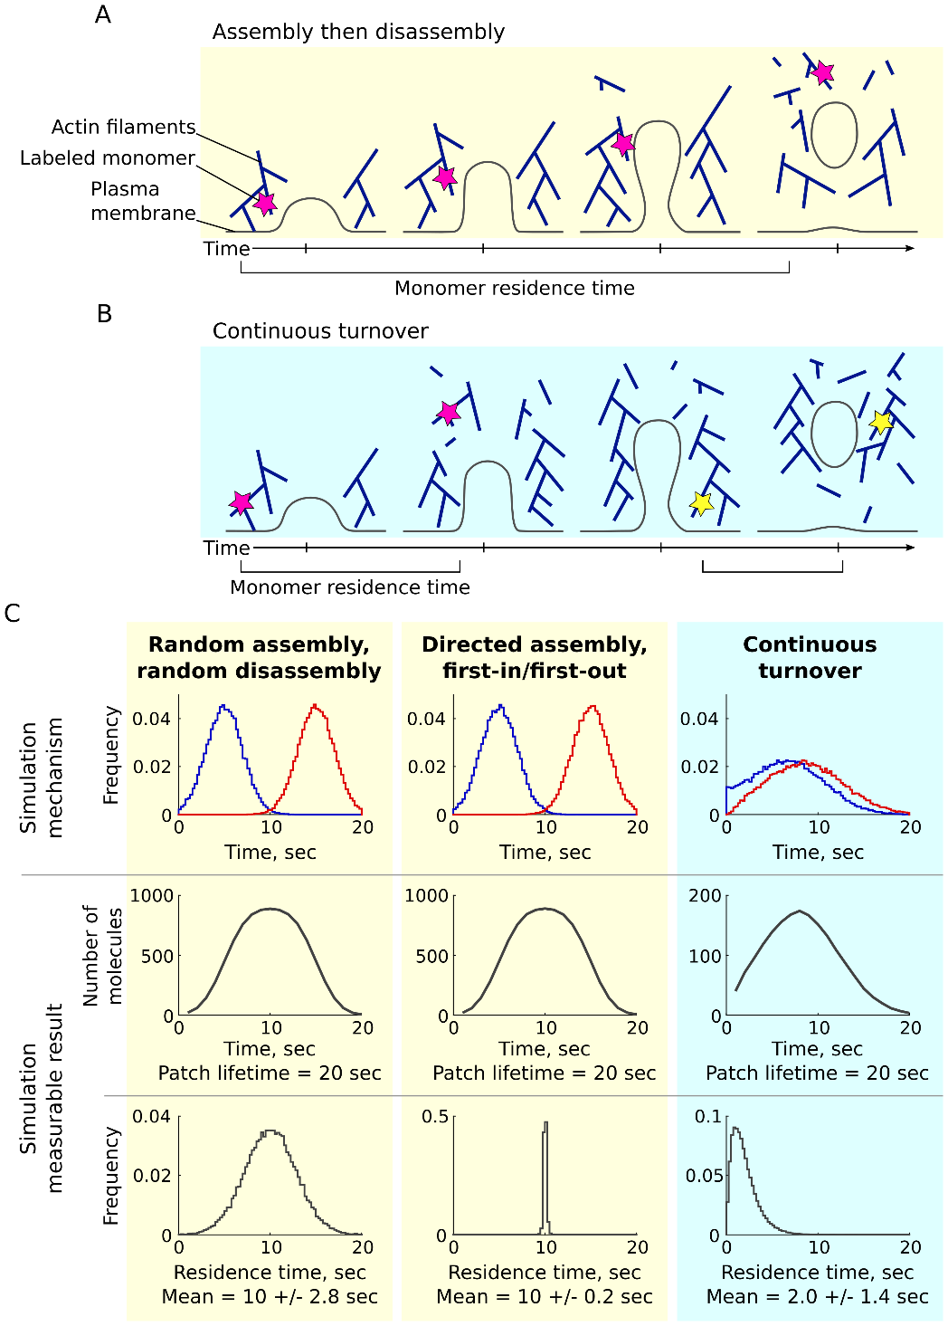
How does actin assemble and disassemble during endocytosis?
Does it turn over?
Two competing hypotheses:
A) Assembly…………….. then ………….…… disassembly
Membrane
1 actin subunit
Actin filament
B) Continuous turnover
Lacy et al (bioRxiv 2019)
Strategy to discriminate between hypotheses:
measure the residence times of individual molecules

Slide 16
Mathematical modeling shows that each mechanism produces different distributions of residence times
Assembly then disassembly
Rates of
Assembly/Disassembly
Distribution of residence times of single molecules
Lacy et al (bioRxiv 2019)

Slide 17

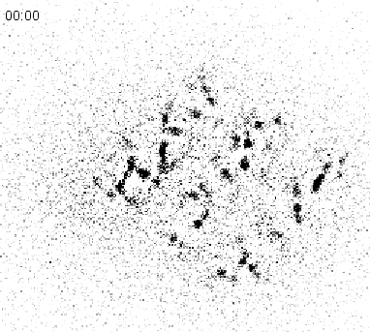
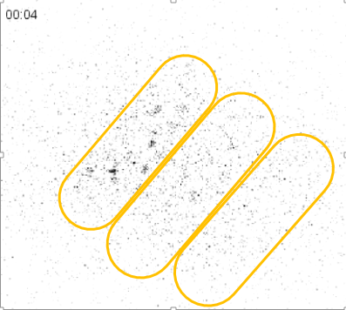
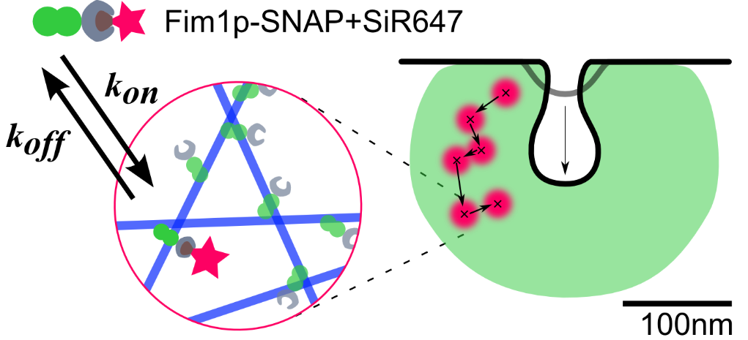
Strategy to measure the residence time of individual molecules
Sparsely label protein of interest with SNAP-tag and very low concentration of SiR dye (Silicon Rhodamine)
At most 1 tagged molecule per endocytic structure
Measure how long the tagged molecule stays at the endocytic site, aka residence times
Mike Lacy
Lacy et al. (2017)
Pil1p-SNAP+SiR

Slide 18
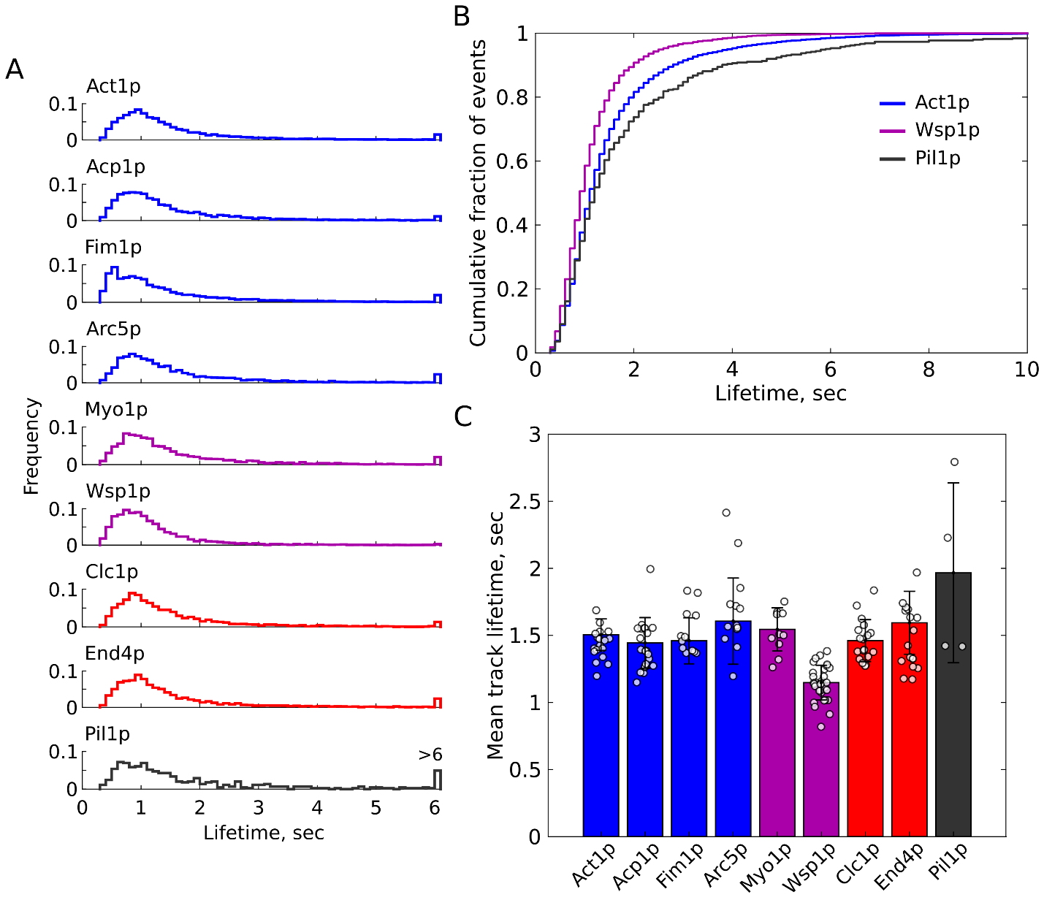
The actin machinery does turn over (~4 times)
Experimental data
Assembly then disassembly
Continuous turnover
Actin
Capping protein
Frequency
The data match with the turnover model
The mean residence time for the actin machinery is ~1.5 s
Virtually no molecule stays for the entire time of the vesicle formation
The actin meshwork turns over about 4 times before the vesicle is pinched off
Crosslinker fimbrin
ARP2/3 complex
Residence time (s)
Lacy et al (bioRxiv 2019)

Slide 19
How can turnover be useful for endocytosis?
Assembly then disassembly
Continuous turnover
Turnover of the endocytic machinery is surprising but we had hints:
Our 2010 mathematical model predicted turnover of the actin machinery (~ 3 times)
Other actin systems (e.g. lamellipodia of motile cells) also turnover / treadmill
More energy from ATP hydrolysis available via actin assembly
More opportunities for the actin meshwork to remodel
Different mechanisms for force production are possible (e.g. elastic gels)
Lacy et al (bioRxiv 2019)

Slide 20
PART III – FORCE PRODUCTION BY CROSSLINKING
How can crosslinking of actin filaments help produce force?
Lacy et al 2018
The endocytic machinery needs to produce >1000 pN
The force produced by actin polymerization alone is probably too small
BUT
Conservative estimate ~ 15 pN
Optimistic estimate ~ 200 to1000 pN

Slide 21
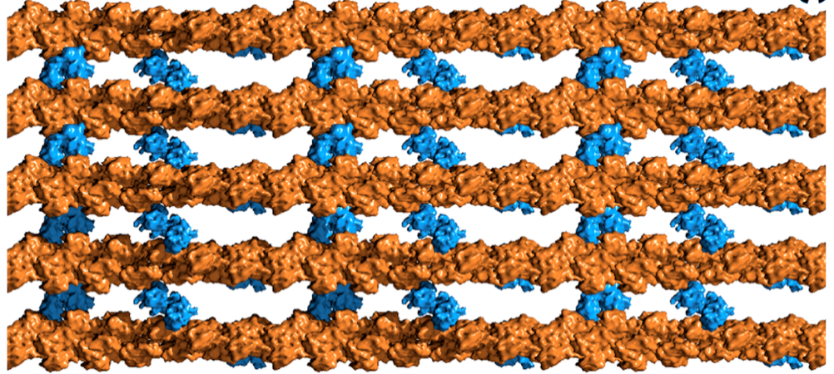
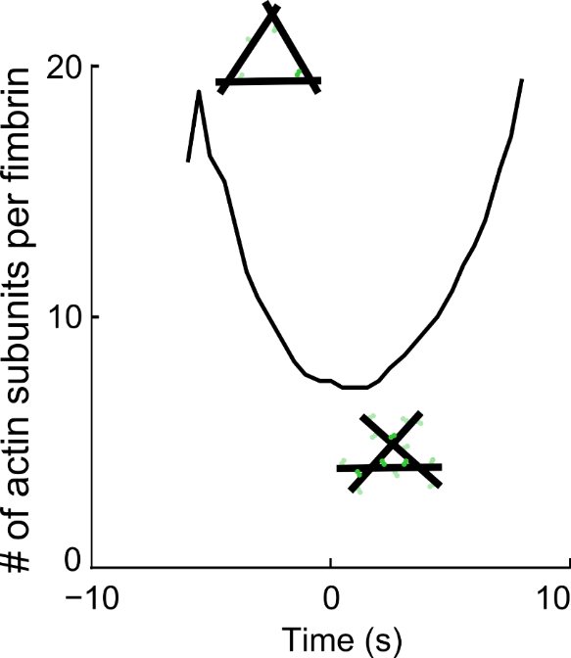
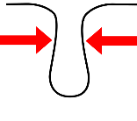
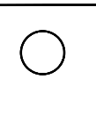
Actin filament crosslinking protein fimbrin is the second most abundant endocytic protein after actin
Actin filaments
Fimbrin
Actin : Fimbrin ratio
Brown et al 2010
The density of actin filament crosslinker fimbrin is very high and changes over time
Can the crosslinker fimbrin participate in force production?
Scission
Berro et al 2014

Slide 22
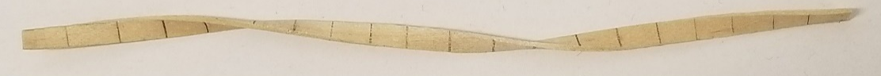
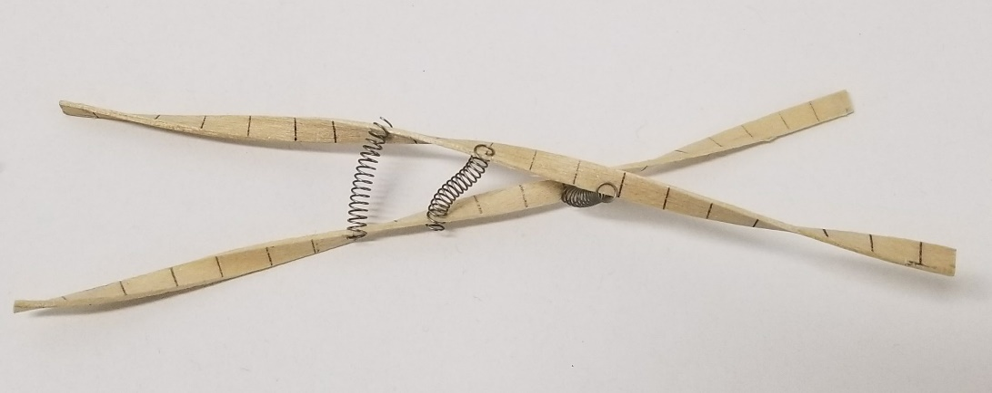

Crosslinking short actin filaments is hard!
Crosslinking twisted filaments is hard!
Endocytic actin filaments are <200 nm,
which mean they remain straight
Their pitch is on the same order of magnitude (1 turn every ~70 nm)
crosslinker binding interfaces virtually never face each other perfectly
Pollard et al
Ma and Berro 2018

Slide 23
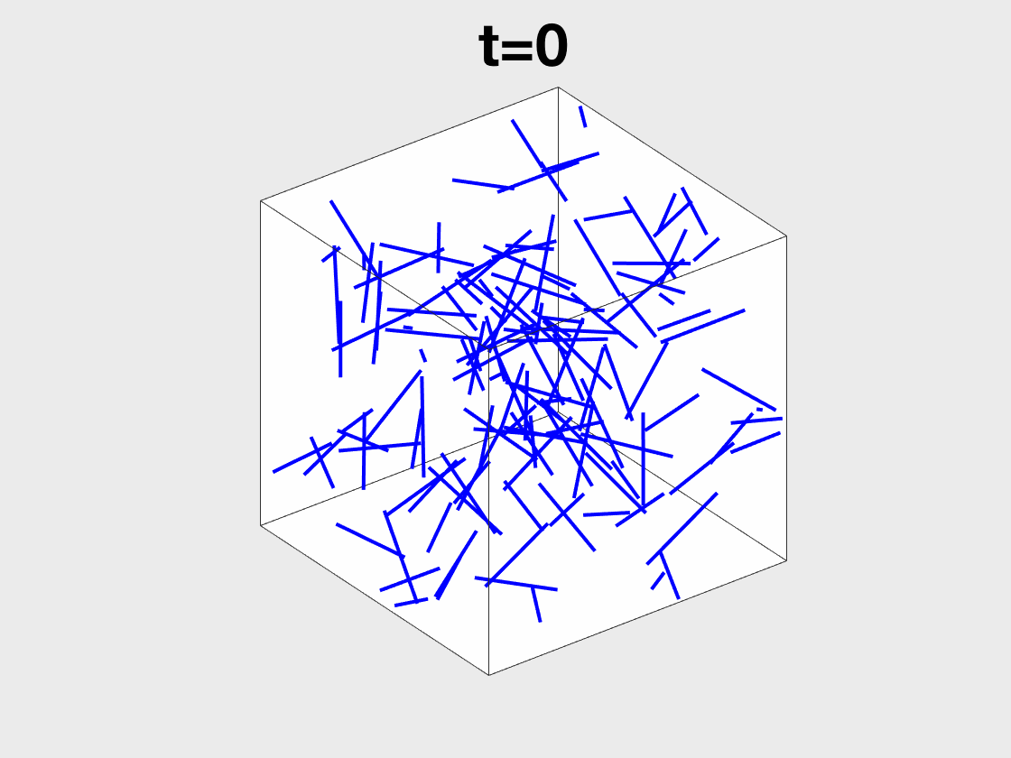
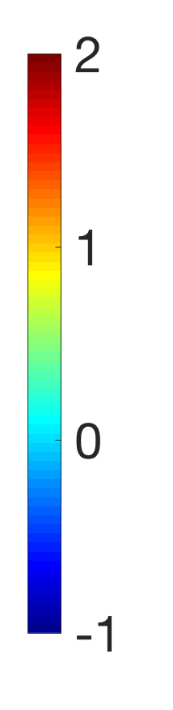
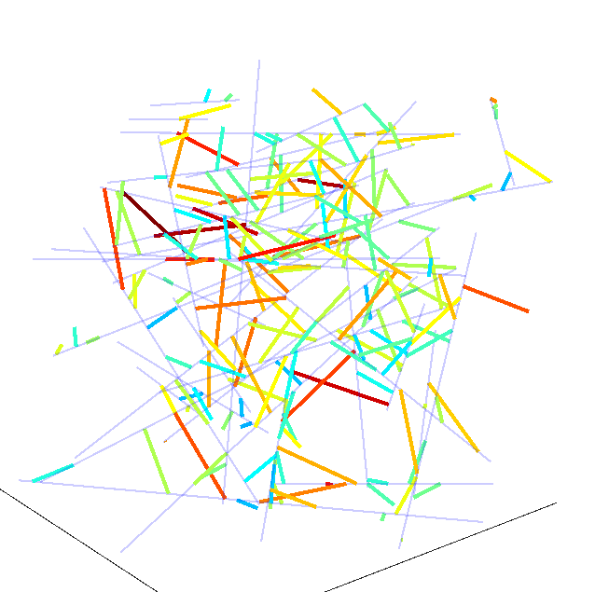
Conversion of chemical energy into elastic energy
Crosslinker extension
Extended
Legend
Blue: actin filaments
Crosslinkers are not shown
Legend
Gray: actin filaments
Crosslinkers are color-coded according to their extension
Compressed
Rui Ma
Ma and Berro 2018

Slide 24
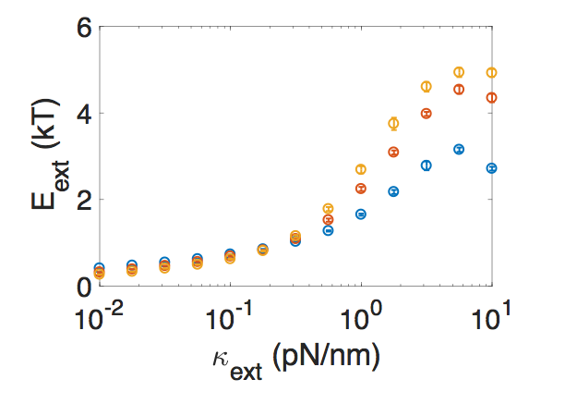
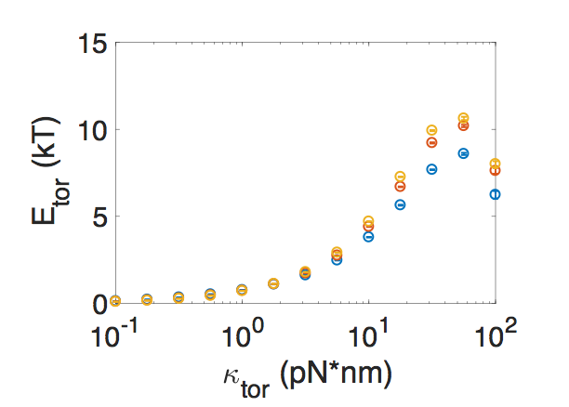
Crosslinkers can store large amounts of elastic energy
~10 k_{B}T per crosslinker = ∼ half the energy of 1 ATP hydrolysis
Extensional energy
Torsional energy
L=81nm
L=81nm
L=135 nm
Torsional Energy (k_{B}T)
Extensional Energy (k_{B}T)
L=135 nm
L=189 nm
L=189 nm
Extensional Stiffness (pN/nm)
Torsional Stiffness (pN*nm)
Ma and Berro 2018
Open question: how is this stored elastic energy used during endocytosis?

Slide 25

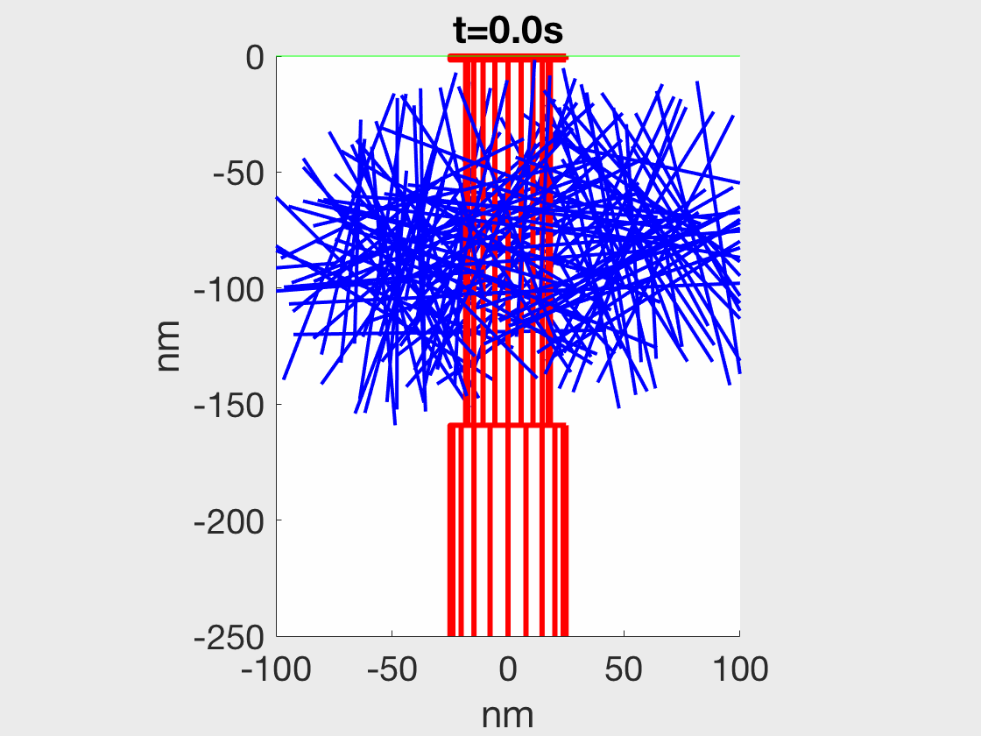
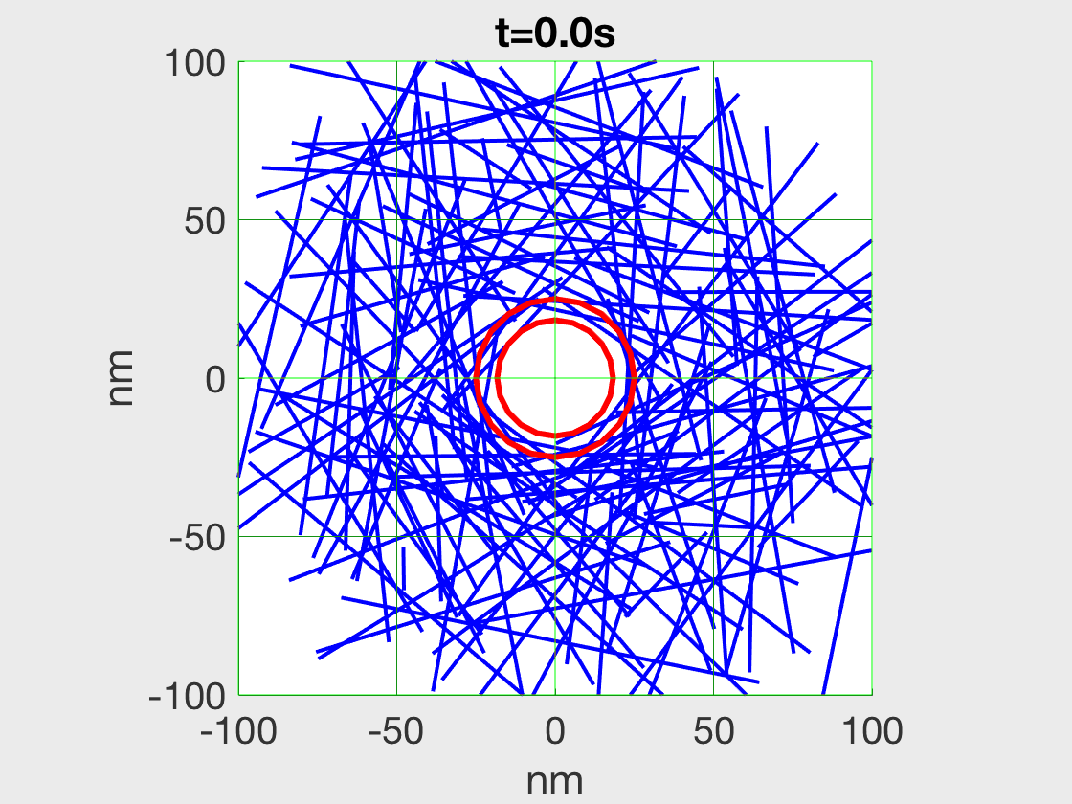
Another way to produce force:
Crosslinking actin filaments around a tube compresses it
Side view
Top view
Stress ~ 0.02 pN/nm²
Or ~ 300 pN around a clathrin pit
Ma and Berro (bioRxiv 2019)

Slide 26


SUMMARY / CONCLUSION
“All models are wrong but some are useful” (Georges Box)
4 models of endocytosis, each one :
Addressed a different question (amount of force, biochemical mechanisms, mechanical mechanisms, etc)
Considered different scales (from nanometer to micron / no space dimension)
Had different levels of details (from individual molecules to continuous ensemble)
All:
were backed by experimental data
aimed at making experimentally testable predictions
Assembly then disassembly
Continuous turnover
Berro (Biophysical Reviews 2018)

Slide 27





Acknowledgements
Join the lab!
All backgrounds are welcome!
Berro lab:
Dr Yuan Ren
Dr Rui Ma
Dr Ronan Fernandez
Xiaobai Li
Neal Ravindra
Ruchira Ray (’21)
Mimi Kostoska (’21)
Former members:
Dr Mike Lacy
Joël Lemière
Collaborators:
David Baddeley
Erdem Karatekin
Yongli Zhang
Funding:
Yale Cancer Center/ACS
NIH / NIGMS
@BerroLab

