Slide 1
Computational modeling of eukaryotic cell migration inspired by experiments
Wouter-Jan Rappel
Department of Physics
UC San Diego
Finding Your Inner Modeler
June, 2019

Slide 2
How might modeling be useful?
It can test potential mechanisms
It can point towards gaps in our knowledge
It can create testable predictions
Parameters can be easily varied
Need good, quantitative data

Slide 3
Modeler
Cell Biologist
Collaboration
Modelist
Intrinsic collaboration
Advantages:
Your experimental collaborator never tells you are hopelessly naïve
Speed and surprising results
Disdvantages:
You are not good at either…
Funding

Slide 4
Eukaryotic cell motility plays an important role in various biological processes
Embryology
Wound healing
Cancer metastasis
Combining theory and experiments can give crucial insights at all three levels.

Slide 5
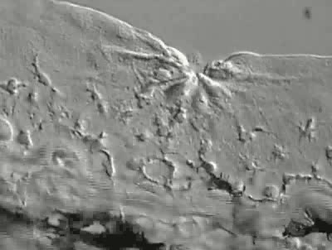
Wound healing
Wound in zebrafish larvae, showing the leukocytes leaving the vein towards the wound.
Paul Martin, University of Bristol

Slide 6
We will discuss:
Adaptation, memory and maximum response
Cell shape, speed, and adhesion
3D cell models
Border cell migration

Slide 7
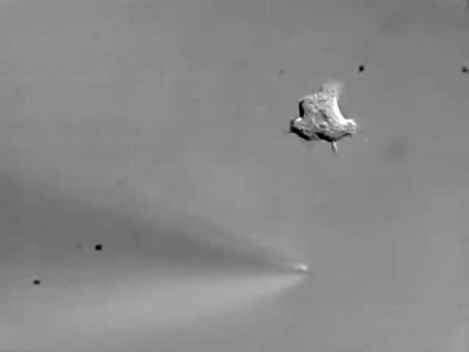
1. Adaptation, memory, and maximum response
Chemotaxing cells know which way to go for shallow gradients with vastly different background levels
c
Dictyostelium
These cells are beautiful
Does adaptation play a role in gradient sensing?
space
System comes back to identical basal level after a change in external environment

Slide 8
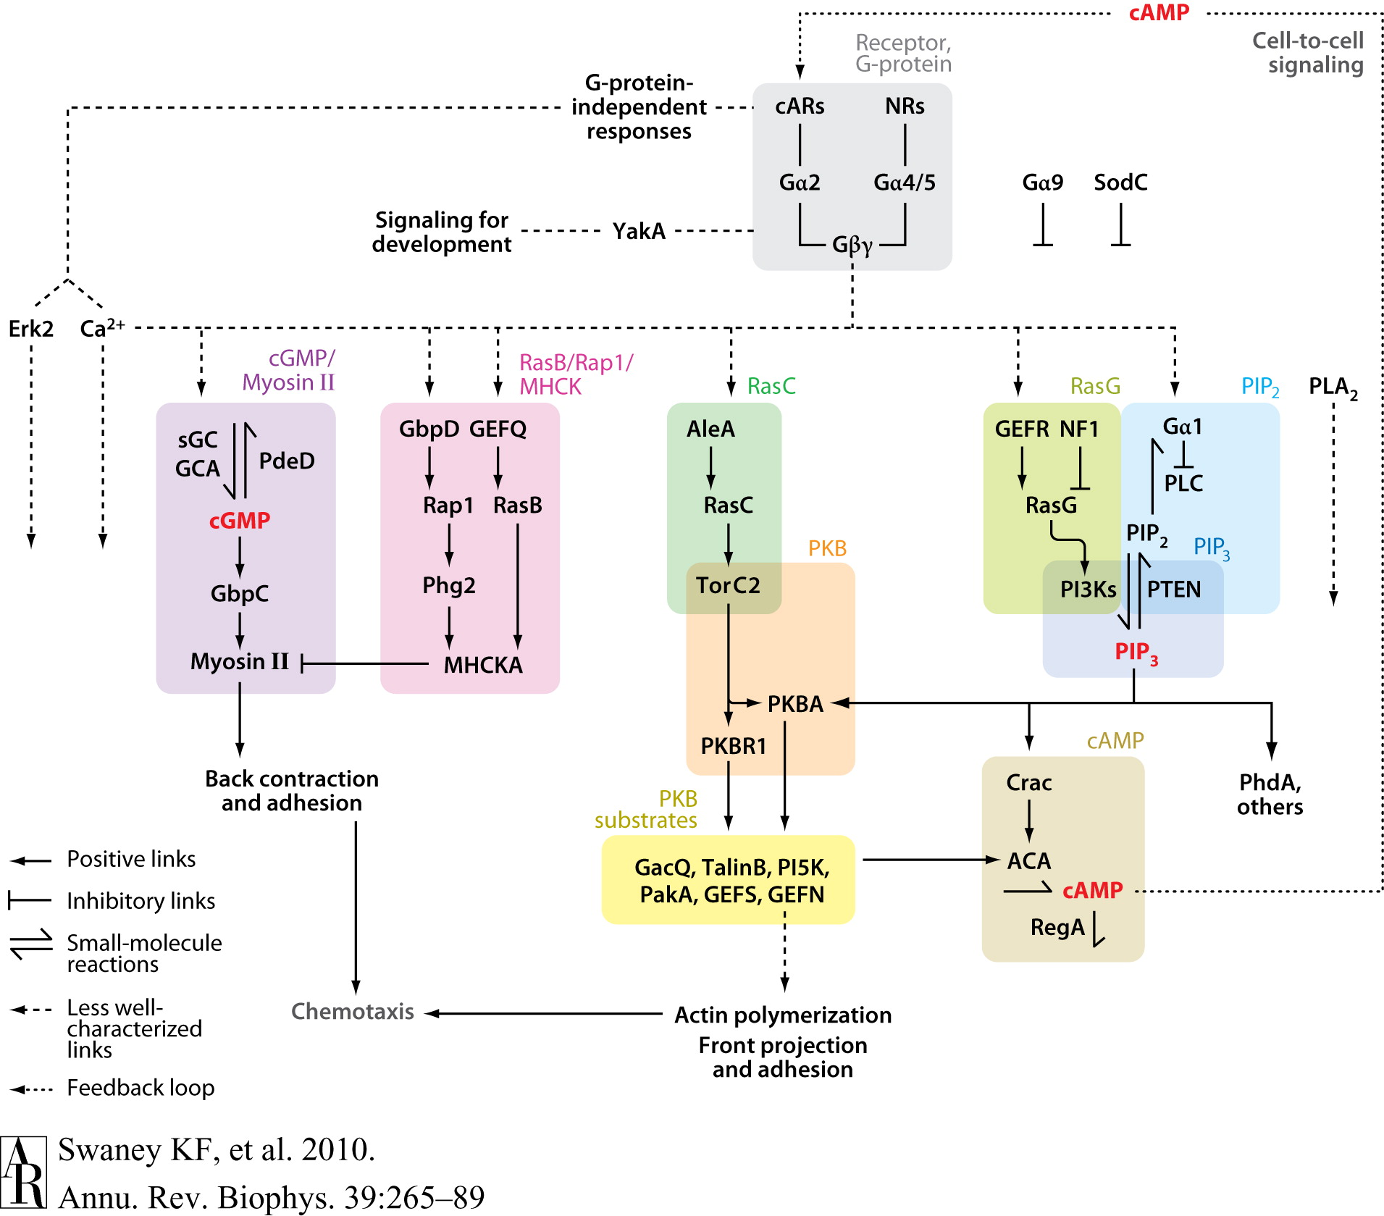
Signaling pathway in Dictyostelium
We measured the response of Ras. This is most upstream component (immediately following the receptor)

Slide 9
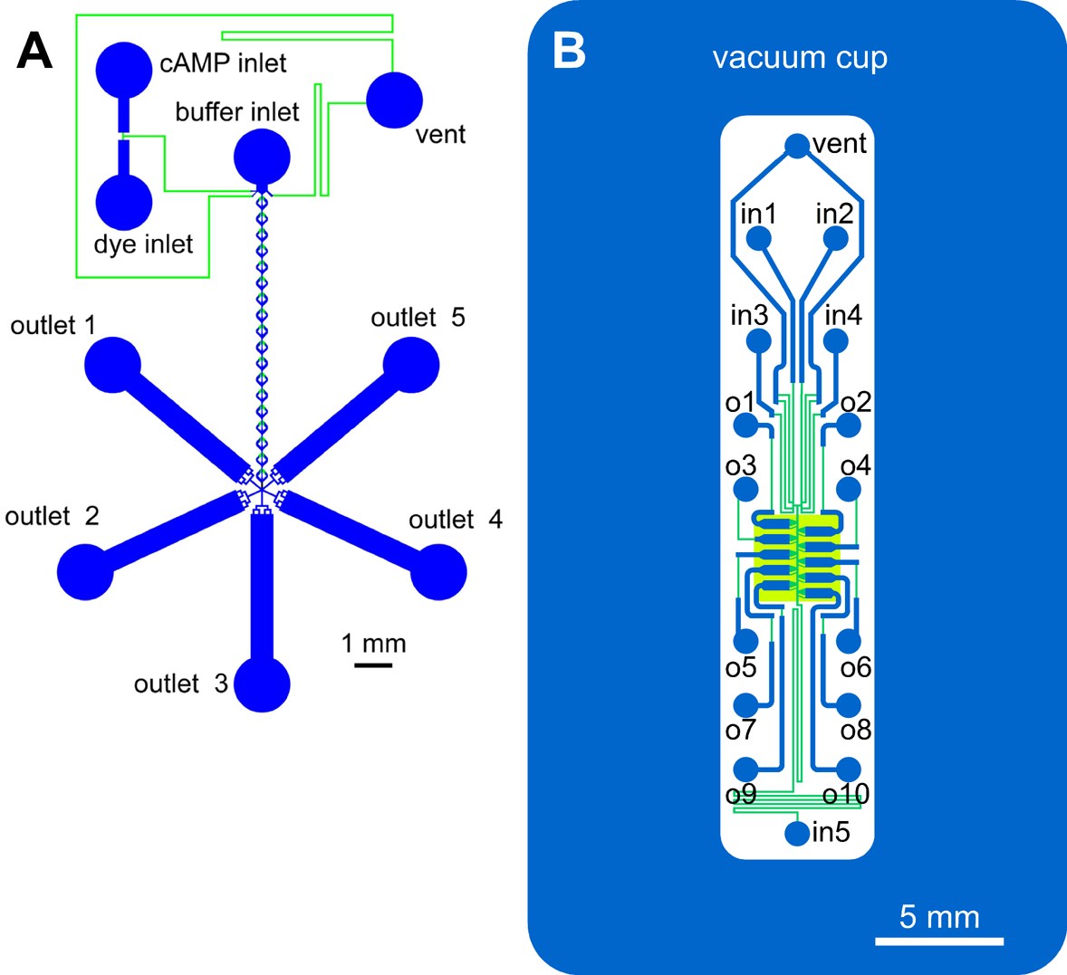
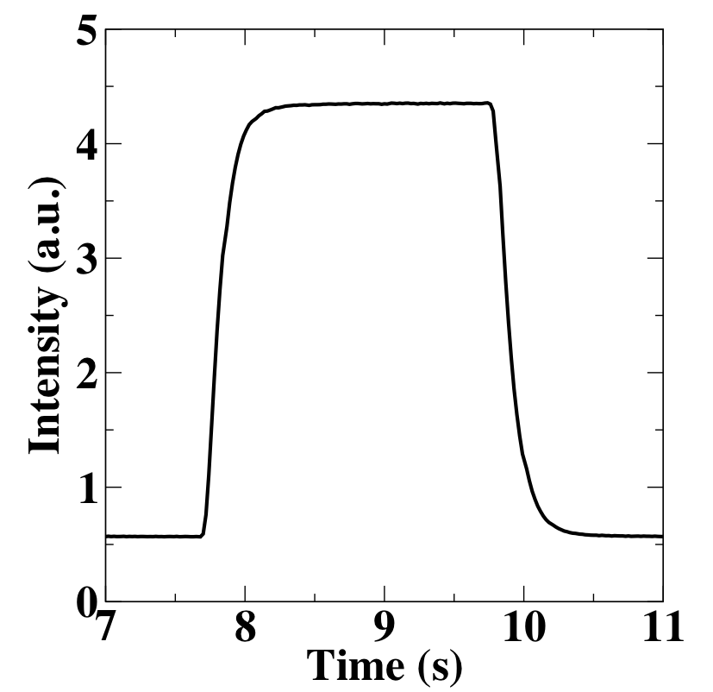
Sudden uniform change in chemoattractant
concentration
Microfluidic device
Can change the concentration up or down within less than 1 s.
Takeda et al., 2012, Rappel and Firtel, 2012

Slide 10
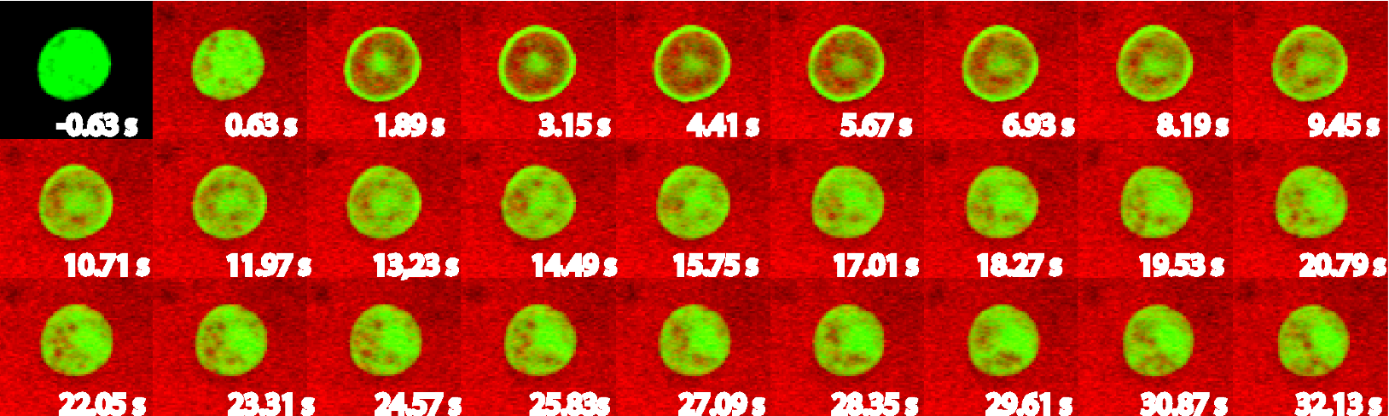
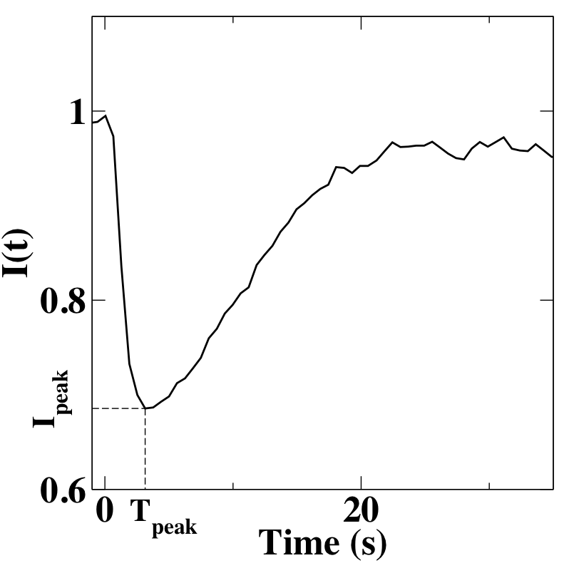
To quantify this, we measure the cytosolic intensity level of activated Ras.
I(35)
We quantified the response time T_{peak} and the amplitude of the response after 35 s, I(35)

Slide 11
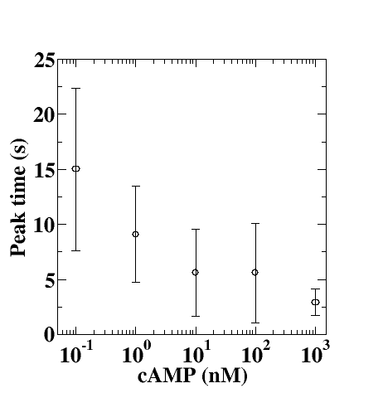
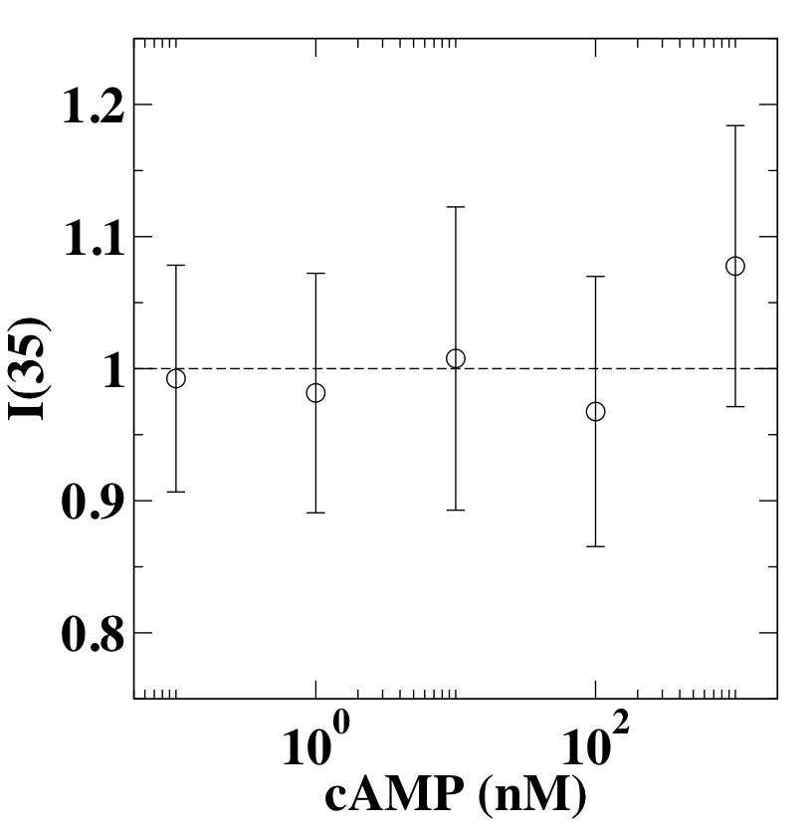
We measured the response after stimuli of different levels
cAMP
Time
Perfect adaptation over a wide range of stimuli
Response time decreases as the stimulus strength increases.
Takeda et al., 2012

Slide 12
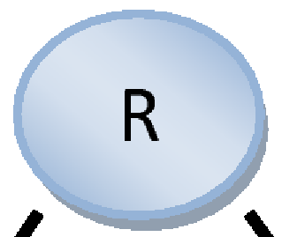
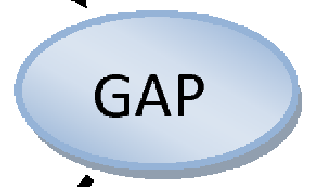

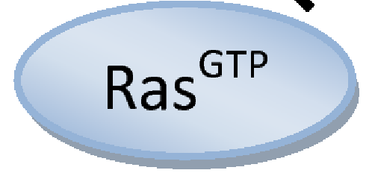
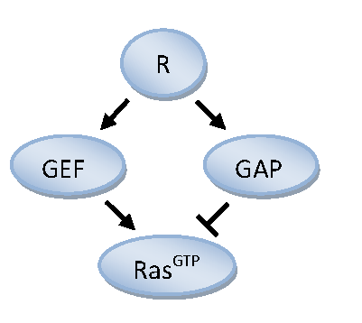
Ras is downstream from the receptors. It is activated by RasGEF and deactivated by RasGAP.
There are only two network topologies that display perfect adaptation:
1. Incoherent feedforward
Ma et al., 2008

Slide 13
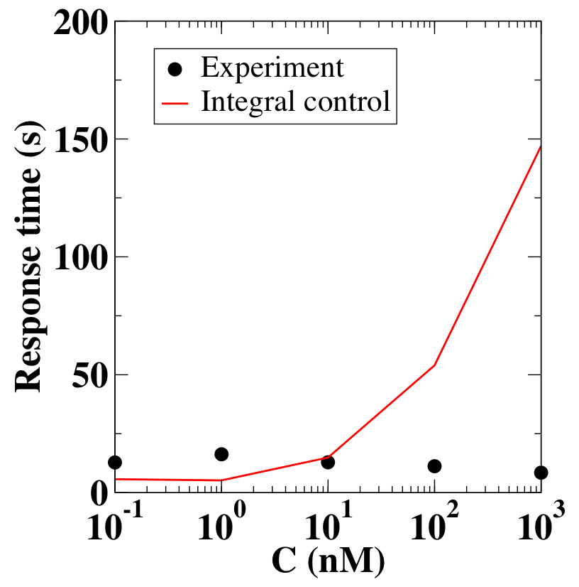
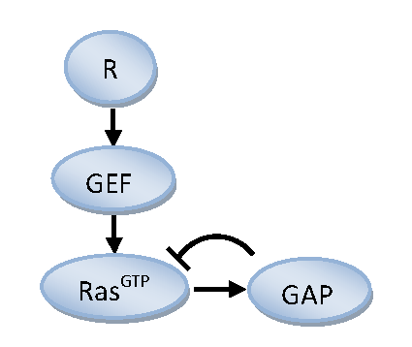
2. Negative feedback loop (Integral control)
Negative feedback loop is not able to fit the experimental results. The response becomes slower for a larger stimulus increase.

Slide 14
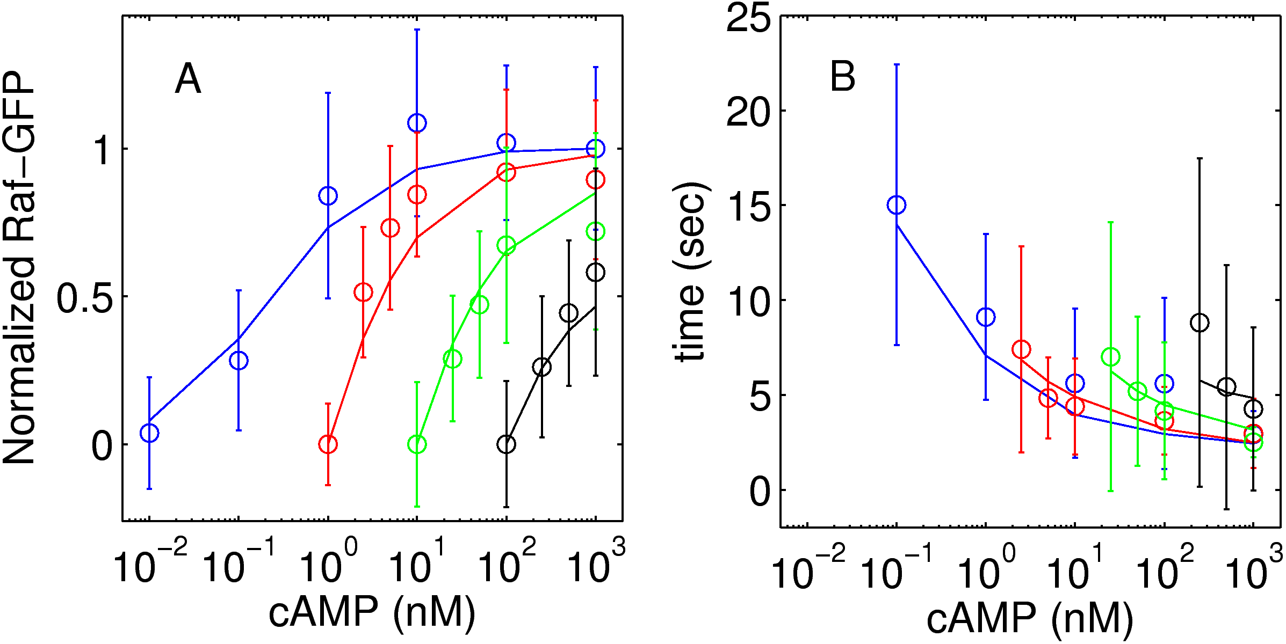
Incoherent feedforward (LEGI) topology gives accurate fits
✔
Combining experiments and modeling allows us to determine pathway topology

Slide 15
Some equations
Steady state: left-hand side is zero
GEF and GAP ~ R
Ras~GEF/GAP
Thus, Ras independent of R (perfect adaptation)

Slide 16
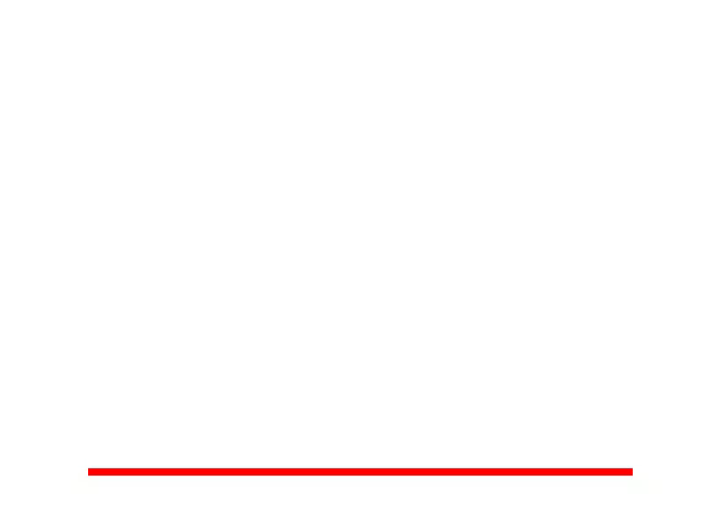
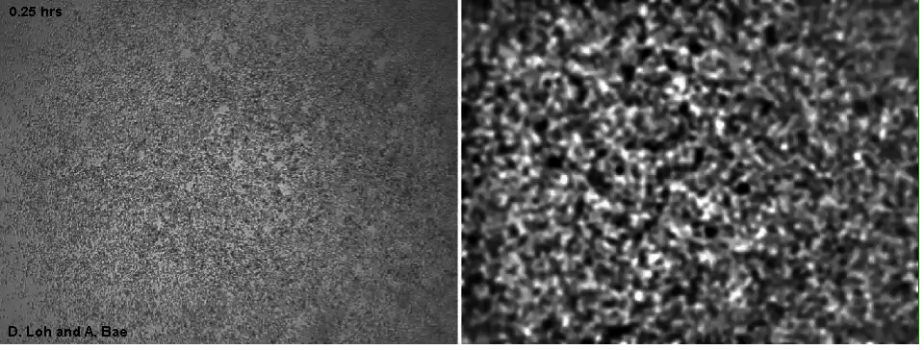
Back-of-the-wave problem
1. Adaptation, memory, and maximum response
Large population of cells
Why don’t cells reverse in the back of the wave?

Slide 17
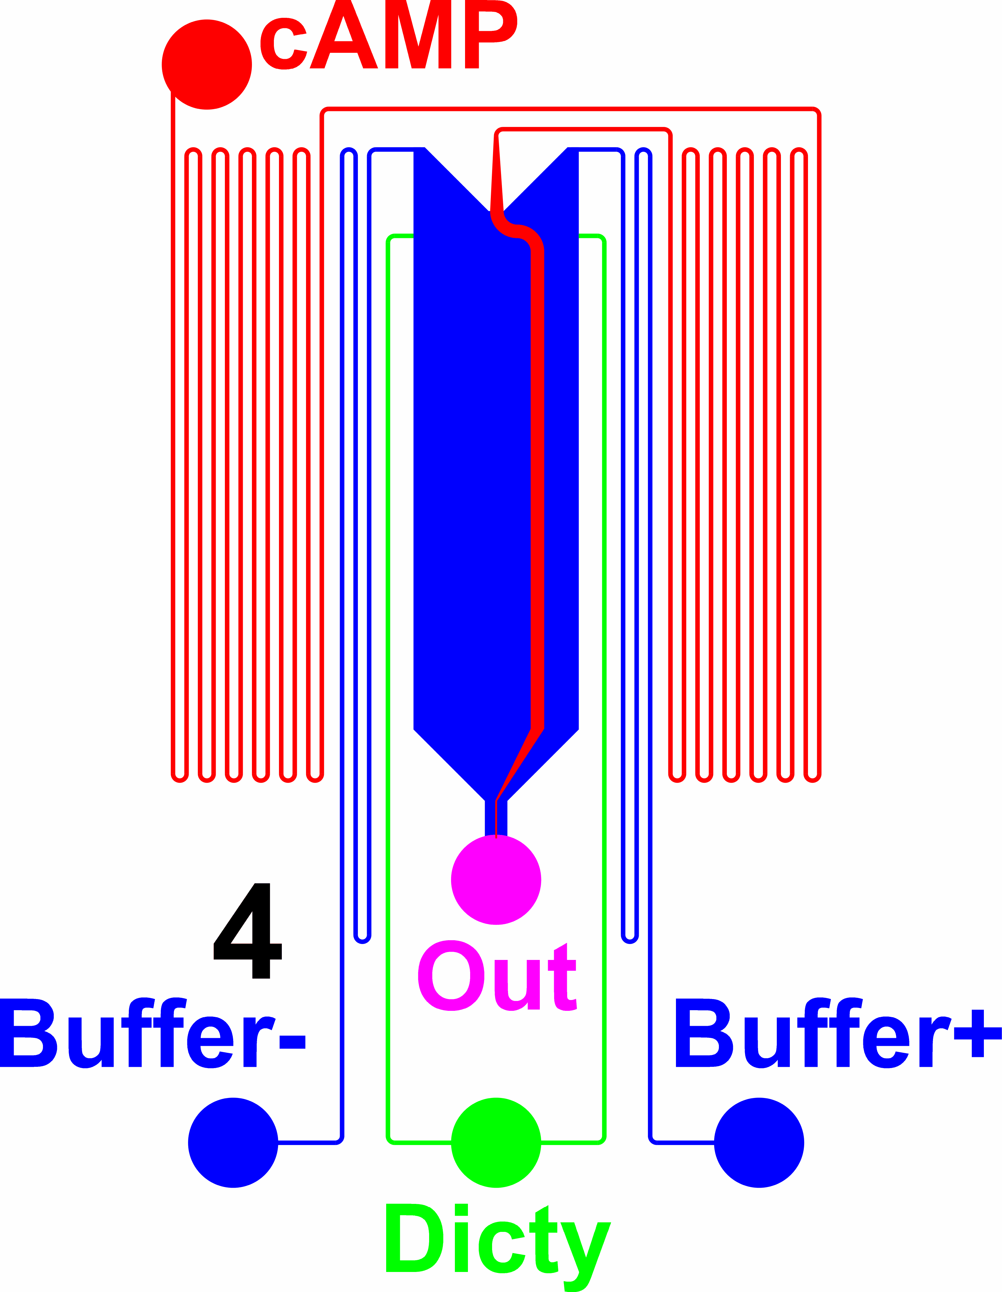
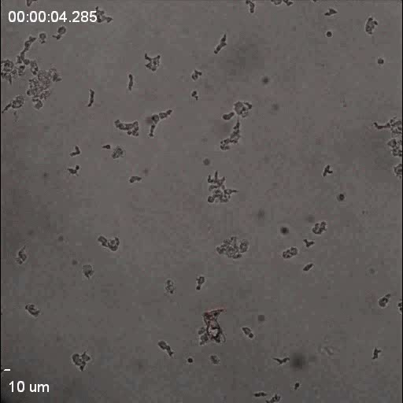
Investigate this experimentally using a microfluidic device that can generate a wave signal.
Wave has three phases:
Positive gradient
Negative gradient
No gradient
Very stable

Slide 18
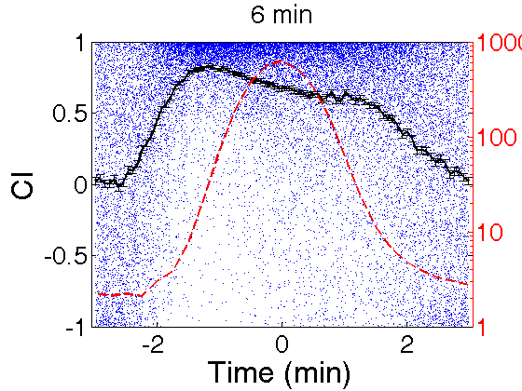
6 min
[cAMP] (nM)
CI: Chemotactic Index

Slide 19
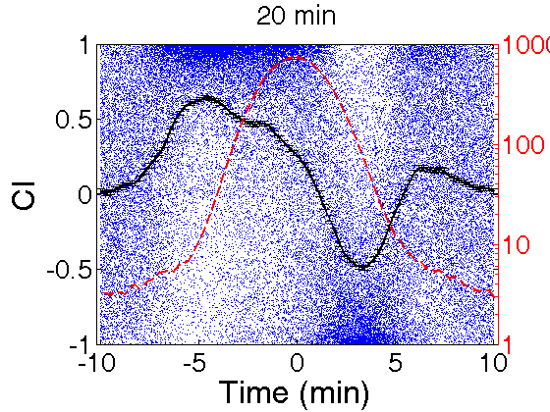
20 min
[cAMP] (nM)

Slide 20
Cells do reverse for slow waves

Slide 21
Our new experimental results can be captured by an expanded model.
Use same
parameters
Adaptive module coupled to bistable module.
Bi-stable module is activated by RasGTP and its output feeds back onto RasGTP.

Slide 22
Memory data; waves
Experiment
Model

Slide 23
Do cell maximize their response by forming clusters?
Is the maximum response a function of the background concentration?
1. Adaptation, memory, and maximum response

Slide 24
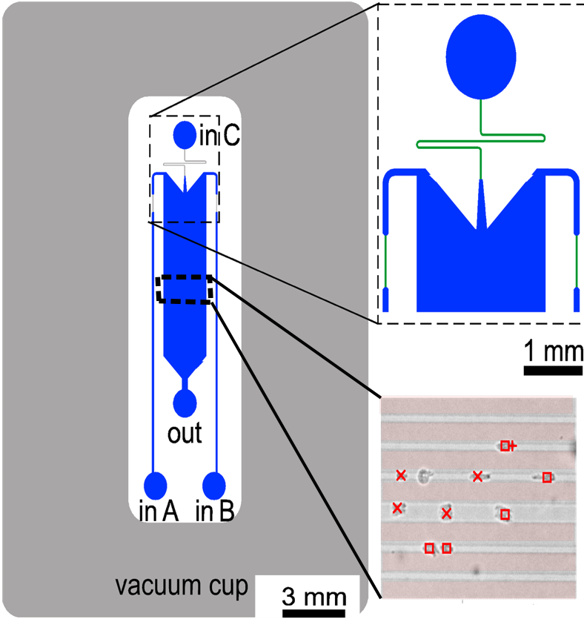
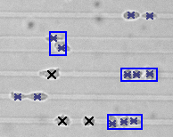
Use micro-patterned substrates: make cells migrate along a line
1D motion is easier to analyze then 2D migration
We can use the lines to investigate single cell vs. cluster migration
1. Adaptation, memory, and maximum response

Slide 25
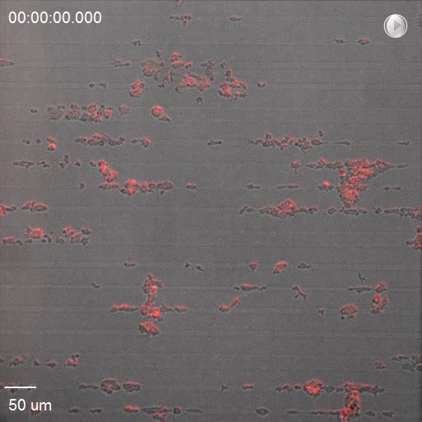
Example of experimental movie
Wide stripe
Narrow stripes
Wide stripe

Slide 26
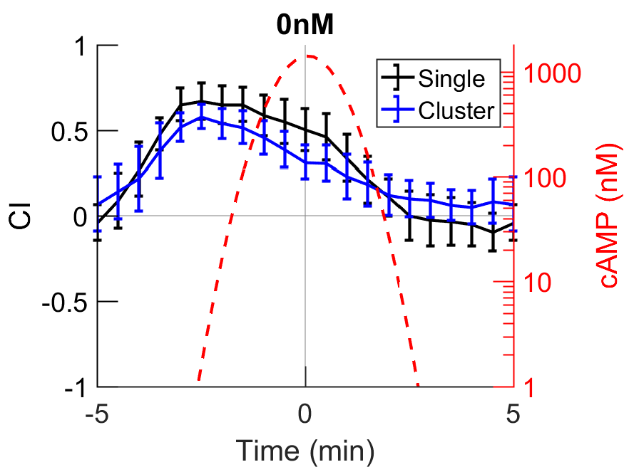
Question 1: do cell maximize their response by forming clusters?
Answer: no

Slide 27
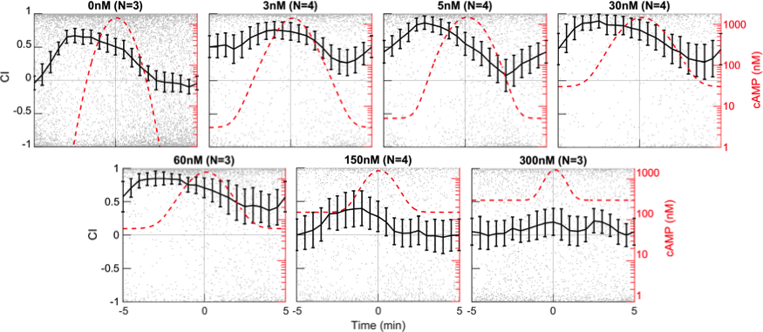
Question 2: Is the maximum response a function of the background concentration?
Answer: yes

Slide 28
Can we again extend the model?
Use same
parameters
Use same
parameters
Adaptation
Memory
Background concentration affects constitutive binding to receptors and has a direct link to memory component M

Slide 29
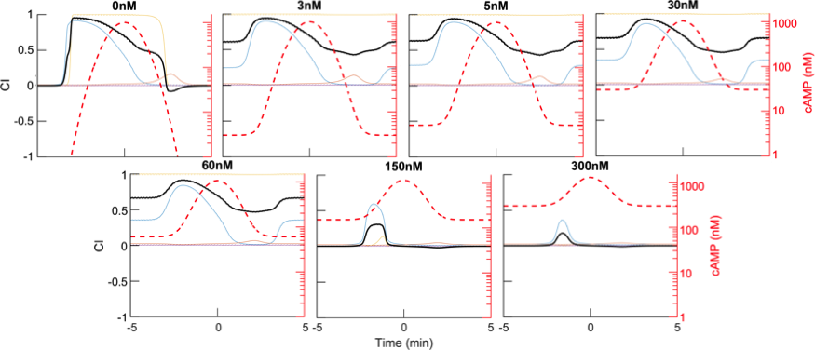
Model results
Compare with:

Slide 30
Quantification: average chemotactic index
0 nM
Steep drop due to bistability

Slide 31

3. 3D Models
Cell motion is intrinsically three dimensional
Cell Migrating Through Collagen Matrix
Betzig group, Janelia (Lattice light sheet microscopy)

Slide 32
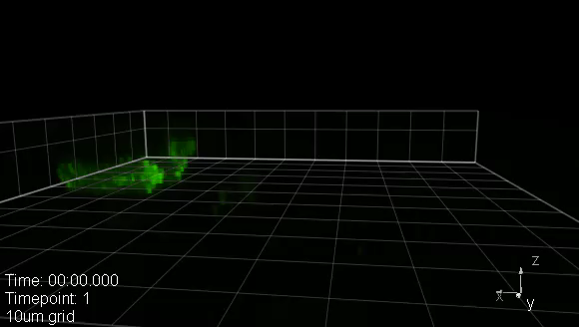
3. 3D Models
Cell motion is intrinsically three dimensional
Amoeboid motion
-random actin-filled protrusions (pseudopods filled with limE-GFP)
-can occur in vertical direction
Modeling deforming cells, especially in 3D, is really challenging

Slide 33
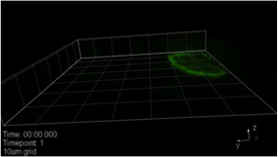
Additional challenge: cells can utilize different modes of migration
Amoeboid motion
Fan-shaped motion

Slide 34
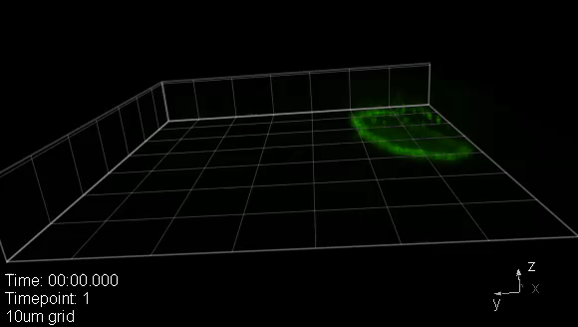
Additional challenge: cells can utilize different modes of migration
Fan-shaped motion
-cell “glides”
-shape is constant
-resembles keratocyte motion
LimE-GFP

Slide 35
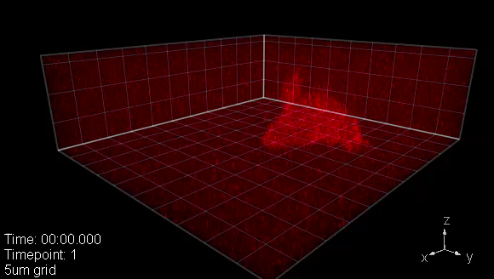
Additional challenge: cells can utilize different modes of migration
Amoeboid motion
Fan-shaped motion
Oscillatory motion

Slide 36
Additional challenge: cells can utilize different modes of migration
Oscillatory motion
-cell cycles between spreading and vertical extensions
-engineered cells
mCherry-FRB-Inp54p
Miao et al, 2017

Slide 37
3D computational cell model
Two key ingredients: 1) Mechanics
2) Biochemistiry
Should be based on experimental data
Should reproduce experimental results
Can test mechanisms
Should be extendable

Slide 38
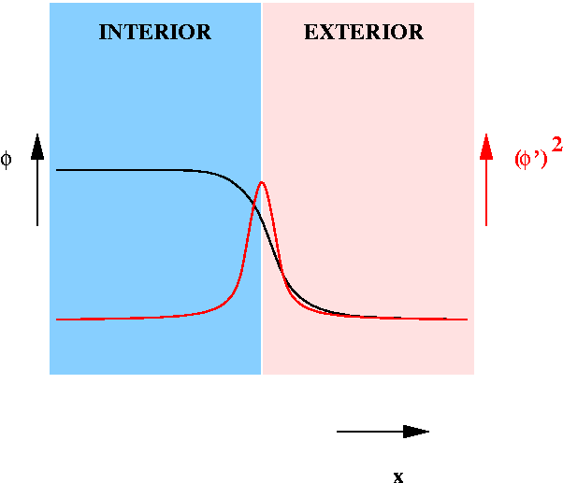
Mechanics:
How to model complex, deforming geometries?
Phase field method avoids tracking of an interface and can implement correct boundary conditions.
Basic idea: Introduce an auxiliary field (the phase field) that takes on one value in the interior and another in the exterior and that varies smoothly from one to the other across a narrow diffuse interface.
Shape changes and membrane specific events can easily be incorporated

Slide 39
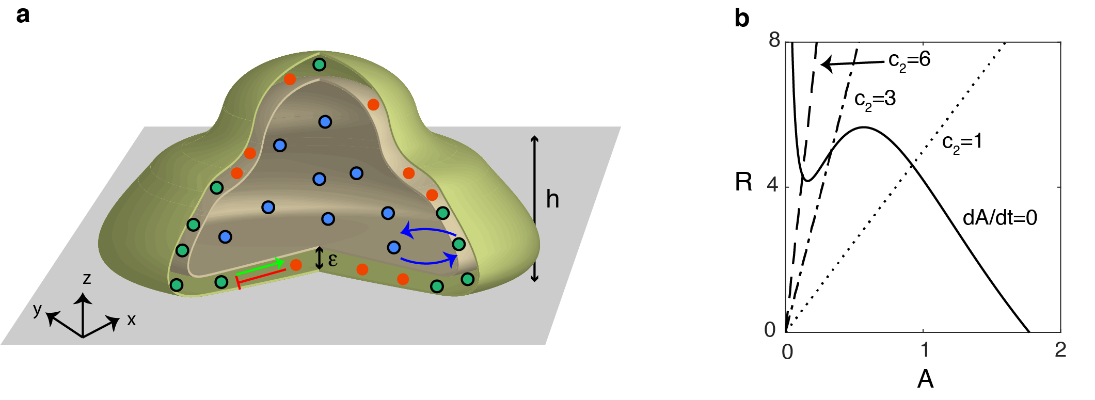
We model a cell moving on a flat surface
Volume and area conservation, bending energy, membrane tension

Slide 40
Biochemistry
Motion driven by output of a two-component intra-cellular model: activator A and inhibitor I
Excitable
Oscillatory
Monostable
Plot nullclines
Changing single parameter can change model dynamics

Slide 41
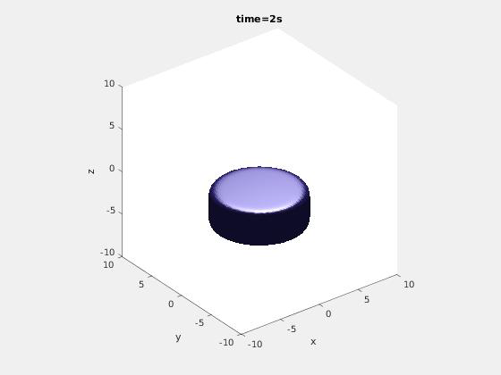
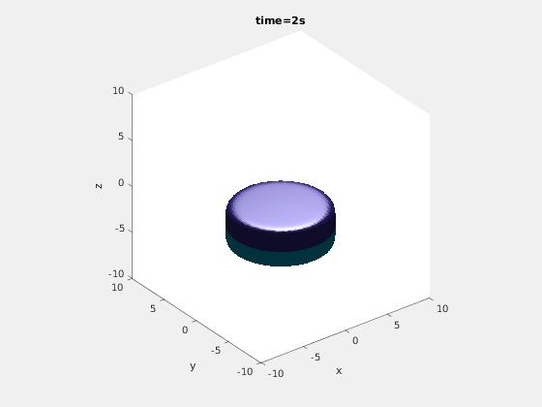

Modeling results
Amoeboid
Fan-shaped
Oscillatory

Slide 42
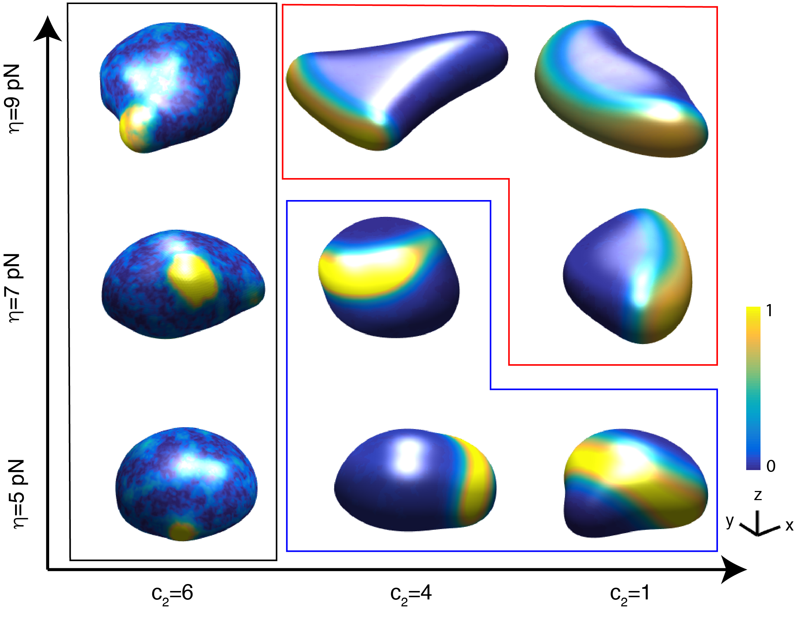
Parameters determine morphology and migration mode
Protrusion strength
Biochemical parameter

Slide 43
What about these waves in the oscillatory cells?
Used lattice light sheet microscopy to investigate

Slide 44
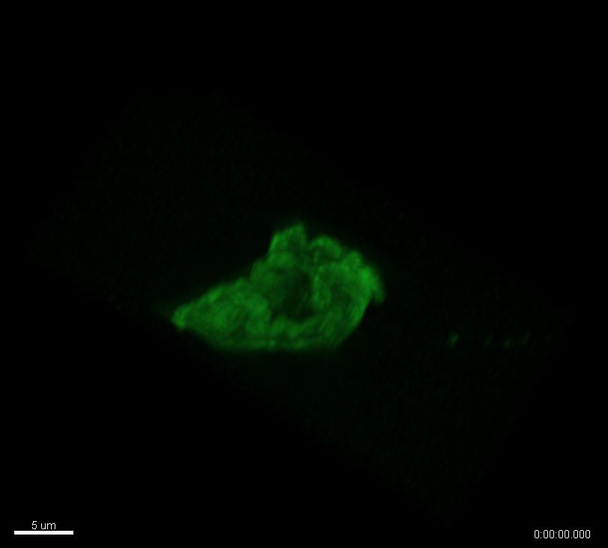
What about these waves in the oscillatory cells?
Used lattice light sheet microscopy to investigate
Qualitatively similar to simulations
Side view of an oscillatory cell
(w/ Samara Reck-Peterson)

Slide 45
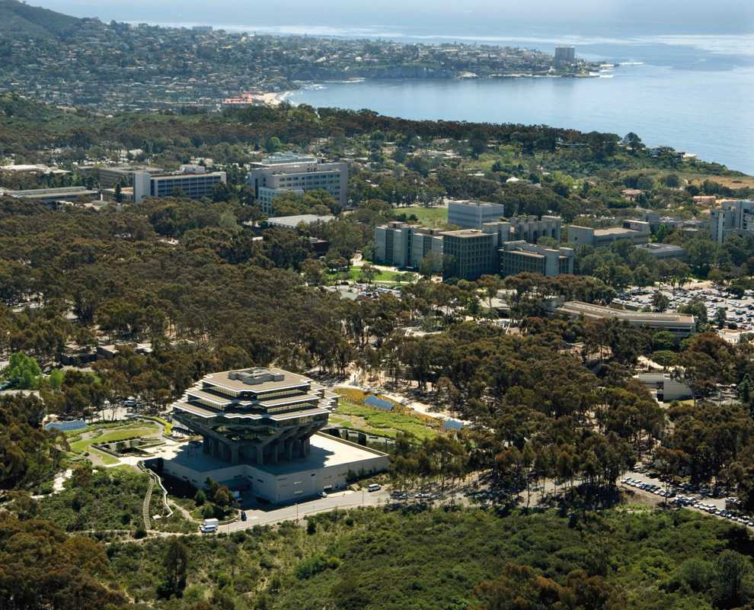
Acknowledgements
Monica Skoge Haicen Yue
Alex Groisman Albert Bae
Herbert Levine Bill Loomis
Michael Erickstadt Danny Fuller
Richard Firtel Kosuke Takeda
Pascale Charest Richa Karmakar
Elisabeth Ghabache Micha Adler
Yuangshen Cao Brian Camley
Peter Devreotes Yuchuan Miao
Samara Reck-Peterson
Funding: NIH, NSF

